Slide 1
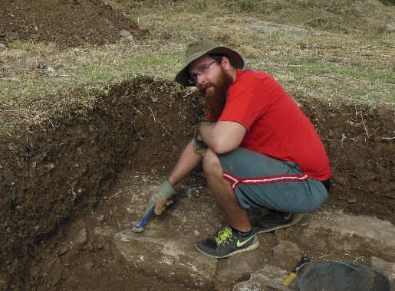
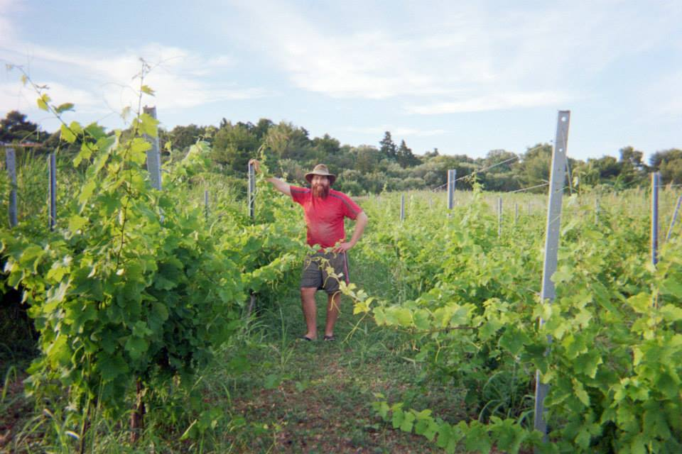
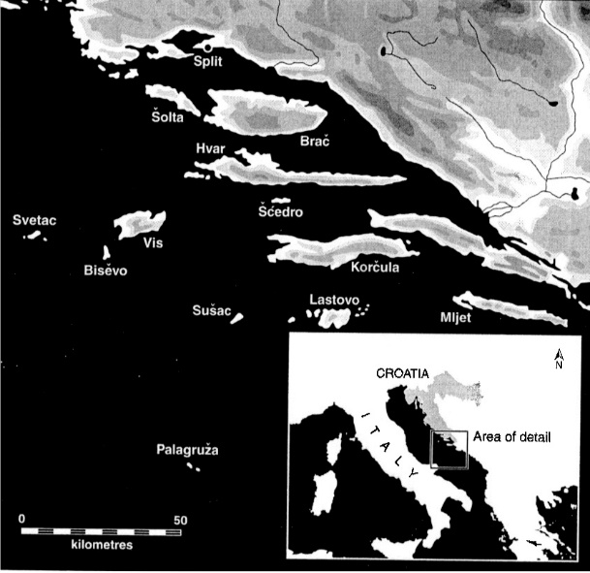
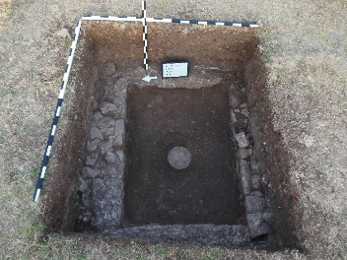
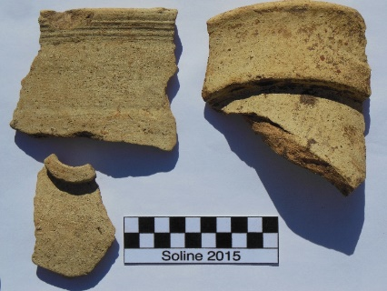
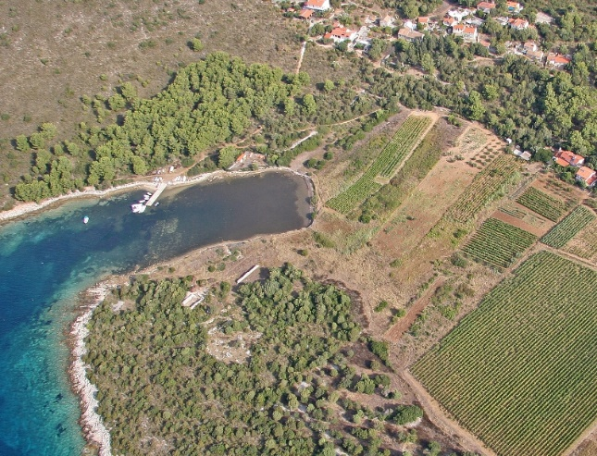
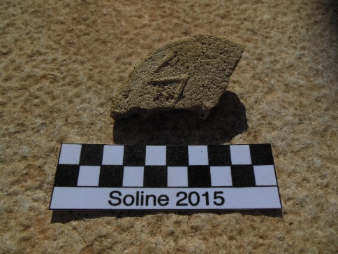
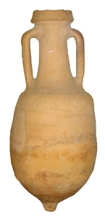
In Vino Veritas: The History of Wine in Ancient Roman Dalmatia
by Andrew Ring
Faculty Mentor: Ivančica Schrunk | University of Saint Thomas
This research was made possible in part by the Grants and Research Office.
This research explores the economic role that viticulture played in the ancient Roman province of Dalmatia in modern Croatia. Through examination of both the archaeological record and ancient written sources it was found that the Romans spread vineyards throughout their empire to economically exploit the natural resources of their territories. When the Romans annexed Dalmatia they found that the only viable land for vines lay along the Adriatic coast. Here viticulture had been practiced possibly as far back as the Neolithic period, and was developed during Hellenistic colonization. Later as the Romans appropriated the region wealthy Roman citizens and veterans obtained land where they developed villas. These villas were large agricultural enterprises that produced a variety of crops. The most profitable cash crop according to ancient sources were grapes for the production of wine. This profitability made viticulture attractive, and caused the further growth of vineyards along Dalmatia’s Adriatic coast and islands.
Sveti Klement
Cleaning the features of a wall in trench 15. (Photo credit: T. Schrunk)
Touring the vineyard of Nikola Colnago near the Soline site (Photo credit: A. Ring)
As part of my study, I participated in the excavation of one such villa on the small island of Sveti Klement in June 2015. This excavation gave me new insights into the lives of the people that originally lived there. Artifacts and features uncovered at the site showed a high standard of living of the residents, and could show their economic activity. Features such as a large basin built with a hydraulically sealed floor may have been used for vinification. Evidence such as the amount of fragments of amphorae and drinking vessels at least can show that there was wine consumption at the site. However, overall the physical evidence for the presence of a vineyard on the island is inconclusive. But from the popularity of wine for it profitability among ancient agricultural writers and its presence at neighboring islands it has been concluded that there most likely would have been a vineyard at the site.
Trench 16 contained the in situ remains of a hydraulically sealed floor and stone collection bowl at its center. (Photo credit: T. Schrunk)
Sherds of Lambolia 2 amphorae used for the transport of wine found at the site. (Photo credit: T. Schrunk)
A complete example of a Lambolia 2 type wine amphora from the 1st c. BCE which was common around the Adriatic. (Photo credit: Archaeology Data Service)
“IA…” stamped amphorae lid that could show part of the name of the owner of the villa maritima at the site (Photo credit: T. Schrunk)
Areal photograph of Soline site near fields and vineyards of the village of Vlaka

